Slide 1






Slide 2
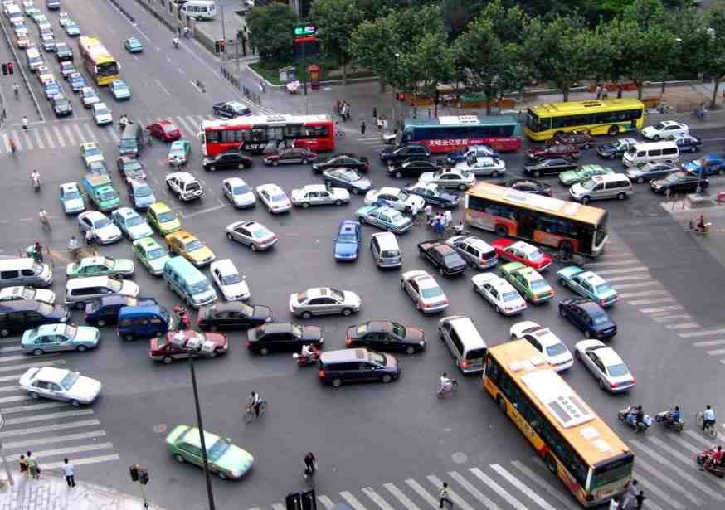
Chapter 1.4
Control Statements

Slide 3
Control statement
Conditional
Looping
Branching

Slide 4
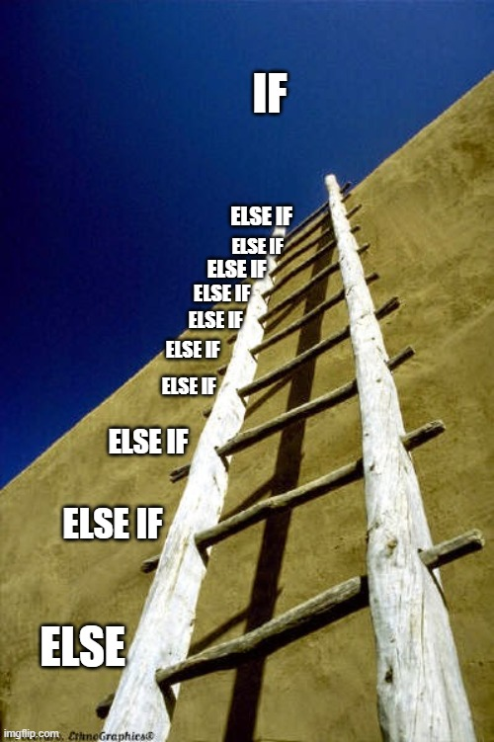
Conditional statement
If
Switch
if else
if else if

Slide 5
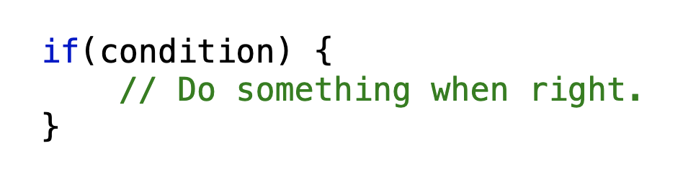
If
“If my age is 40 years old, i will buy a new house”
Age = 40?
True
Buy a new house
False
Program continue

Slide 6
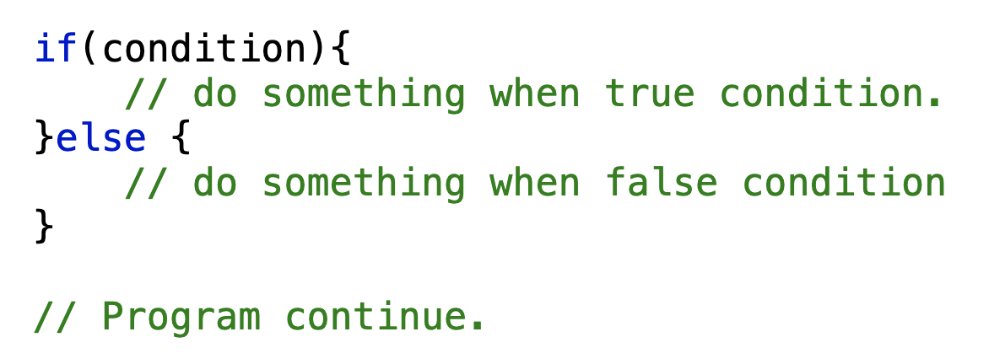
If else
“If my age is 40 years old, i will buy a new house or else i will buy a old car.”
Age = 40?
False
True
Buy old car
Buy a new house
Program continue

Slide 7
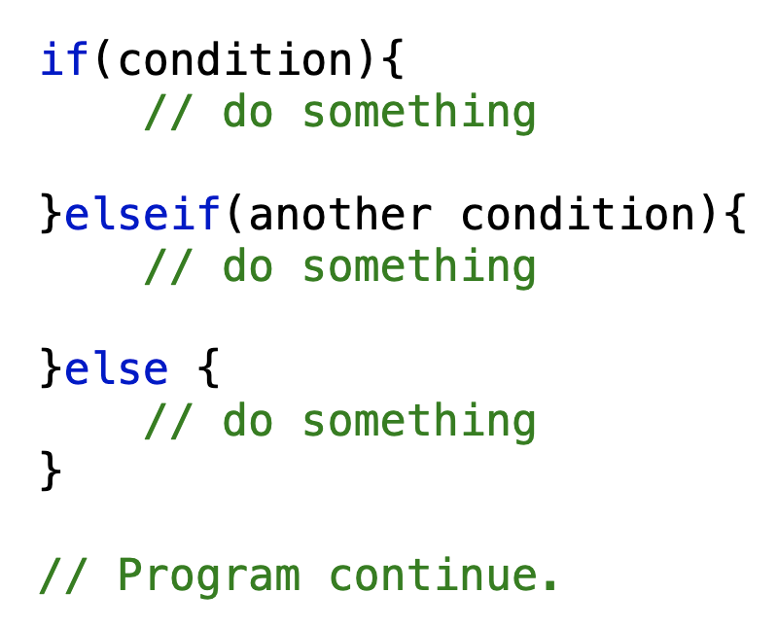
“If my age is 40 years old, i will buy a new house or else if my age is 60 i will retire , else i will buy old car.”
If elseif else
Age = 40?
False
True
Age = 60?
Buy a new house
True
False
I will retire
I will buy old car
Program continue

Slide 8
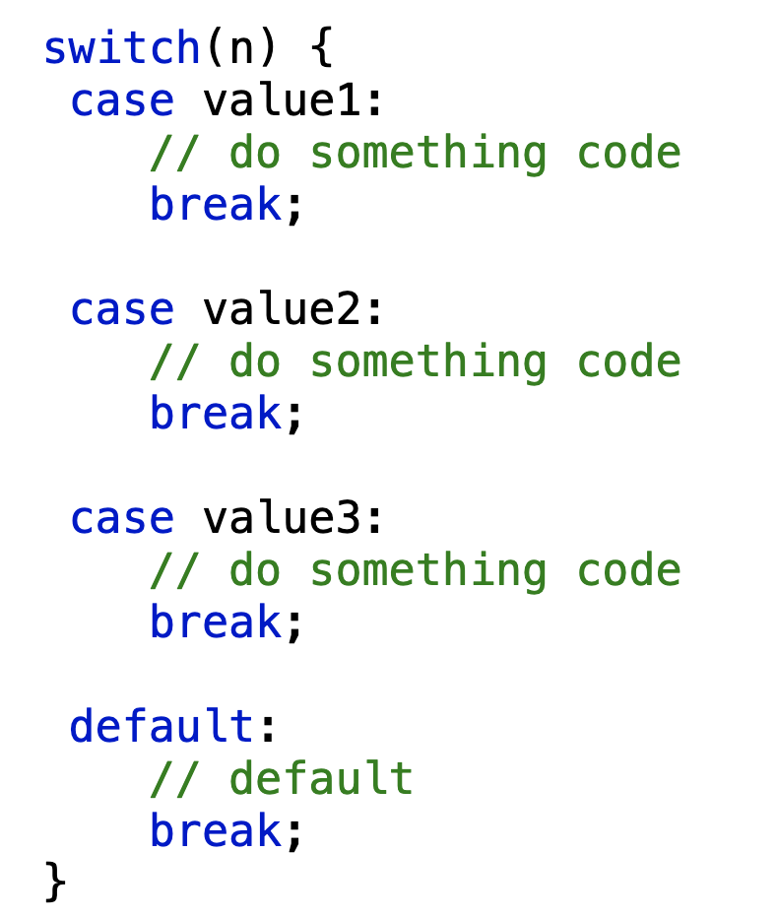
“If my age is 40 years old, i will buy a new house or else if my age is 60 i will retire , else i will buy old car.”
switch
Switch(age)
40
Buy a new house
60
I will retire
Default
I will buy old car
Program continue

Slide 9

Conditional Loop/Looping statement
for
while
do while
for each

Slide 10
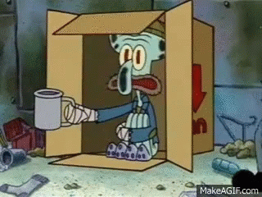
I have 0 balance now, until i have Rs 100 i will keep begging with you.

Slide 11
I have 0 balance now, until i have Rs 100 i will keep begging with you.
start
for(initialization, condition, incre/decre ) {
// Code here
}
money++
<100?
true
Beg money
for(int m=0, m<100, m++ ) {
System.out.println(“Beg money”); }
false
exit

Slide 12
I have 0 balance now, until i have Rs 100 i will keep begging with you.
Initialization;
while(condition) {
// code here
increment/decrement;
}
start
money++
<100?
true
Beg money
int money=0;
while( money<100) {
System.out.println(“Beg money”);
money++;
}
false
exit

Slide 13
I have 0 balance now, until i have Rs 100 or more i will keep begging with you.
Initialization;
do(
//code here
increment/decrement;
) while(condition);
}
start
Beg money
money++
true
<100?
int money=0;
do(
System.out.println(“Beg money”);
money ++;
) while(money < 100);
}
false
exit

Slide 14
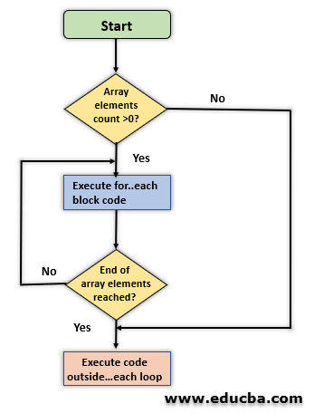
foreach
I have 10 place in my bucket list, i will not die until
I visit every place.
int array = {1, 2, 3, 4, 5, 6, 7, };
foreach(datatype element : array) {
// code here
}

Slide 15
